Slide 1
Public Policy and Gender Workshop, with emphasis on the budget process
Facilitator:
Magdalena Garcia Hernandez, MIRA Mexico
garciamagdalenah@gmail.com

Slide 2
Index
Preamble
To understand what we are doing
What is sought with the United Nations Global agenda
The possibility of using an instrument that may be applied in most countries of the world.
Exercise
General basics concepts
Public finances
Public budget
Macroeconomy
Analysis of Fiscal Policy from four foundations
The principle of Equality, human rights and the right to the city
Basic concepts of gender
Gender Sensitive Budgets
The stages, mechanisms and instruments of public policy
Countries and regions that apply the Management for Results in the design in governmental programmatic-budgetary
Approaches to the inclusion of women in development, their evolution over time and their present coexistence
Practical needs and strategic interests
Fundamental recommendation
ANNEX of Inequality Gaps

Slide 3
Preamble
To understand what we are doing

Slide 4
What is sought with the United Nations Global agenda
… " Our goal is to end poverty and hunger, and to achieve sustainable development in its three dimensions through promoting inclusive economic growth, protecting the environment, and promoting social inclusion. We commit to respecting all human rights, including the right to development. We will ensure gender equality and women’s and girls’ empowerment. We will promote peaceful and inclusive societies and advance fully towards an equitable global economic system in which no country or person is left behind, enabling decent work and productive livelihoods for all, while preserving the planet for our children and future generations."

Slide 5
The possibility of using instruments that may be applied in most countries of the world.
This workshop considers international guidelines for the design of public policy.
Since the beginning of the structural adjustment policies, the areas of approval of public policy have increased. Period of the internationalization of the State.
Not only the national statistics systems would be homologated, with all that this meant in terms of national accounts, but also the scope of public management, to achieve what was called "THE NEW ECONOMY".
Such management was proposed by results, under efficiency, economy, quality and effectiveness approaches of the government, within the framework of neoliberal policies that propose more market and less state.
These policies have generated a greater concentration of income, and therefore an increase in inequalities, which are sought to revert with the guidelines established by the United Nations Global Agenda: NAU, Paris Agreement, Sendai Framework and Action Agenda of Addis Ababa to fulfill the 2030 Agenda of the Sustainable Development Goals (SDG).
This process of standardization of instruments and guidelines on public policies was accentuated with the beginning of the SDGs, which unlike the MDGs that only considered poor countries, the 2030 / ODS Agenda included the commitment to act of all countries Member of the United Nations to fulfill them.
The good news is that the Management for Results instruments are useful for reorienting public policy in the sense established by the Global Agenda within the framework of The Right to the City with a Gender Perspective. The RESULTS should be the progressive advancement of women and men in the enjoyment and access to their rights under conditions of equality. BECAUSE WITHOUT HUMAN RIGHTS THERE IS NO DEVELOPMENT AND WITHOUT EQUALITY BETWEEN WOMEN AND MEN, THERE IS NO SUSTAINABLE DEVELOPMENT.

Slide 6
Exercise
Investigate the following for your country:
Does the Constitution consider human rights?
Is public policy designed through results management?
Does the public budget consider resources for women and equality between women and men?
If these budgets exist, what percentage are of the total expenditure?
Is there a system for evaluating the performance of applied public policy that allows measuring the closing of inequality gaps between women and men?
Are there citizen mechanisms for monitoring public policy such as comptrollerships, observatories or some others?

Slide 7
Basic concepts
To introduce us to the issue of equality between women and men

Slide 8
The basic knowledge
Public Finance and Management by Results (MbR)
Human rights
Gender Perspective

Slide 9
Public finances
Management by results

Slide 10
Public budget
Direct (ISR)
Taxes
Currents
Indirect (VAT)
Ordinaries
Capital
Rights payment
Income
No tributaries
Products
Extraordinary
Indebtedness
Exploits
Current expenditure
How is it spent? Economic Classification
Budget
Investment Expense
Economic development
What is it spent for? Functional classification
Social development
Programmable Expense
Government
Spending
Government powers
Who spends? Administrative classification
Ramos
How is the budget classified in your country?
Non-programmable expenditure
Federalized expenditure
Payment of public debt
Notes:
CONCEPTOS DE INGRESOS PÚBLICOS
APROVECHAMIENTOS.
Ingresos ordinarios provenientes de las actividades de derecho público que realizan los gobiernos. En términos generales, se derivan del incumplimiento de las obligaciones fiscales de los contribuyentes; son recibidos en forma de rezagos, recargos, reintegros, multas y sanciones.
DERECHOS.
Contribuciones establecidas en la ley por el uso o aprovechamiento de los bienes de dominio público, así como por los servicios que presta el estado en sus funciones de derecho público, excepto cuando se prestan por organismos descentralizados. Los ejemplos son los ingresos del Registro Civil, Registro Público de la Propiedad, licencias y permisos, y agua potable.
PRODUCTOS.
Ingresos que perciben los gobiernos por actividades que no corresponden al desarrollo de las funciones propias de derecho público, sino por la explotación de sus bienes patrimoniales, se incluyen la enajenación de bienes muebles e inmuebles, los arrendamientos e intereses.
TRANSFERENCIAS.
Traslado implícito o explícito de recursos del sector público al resto de la economía o a otros niveles de gobierno, ya sea en dinero o en especie, sin recibir por ello contraprestación directa alguna y únicamente condicionando su asignación a la consecución de determinados objetivos de política económica y social.

Slide 11
Macroeconomic
It is the study of the behavior of the economy as a whole. It examines the overall level of production, employment and prices in a country. Their scope differs depending on the role assigned to the government in the economy. The phrase about it is: how much state, how much market?
Production
High level
Rapid growth rate
Employment
High level of employment
Low level of involuntary unemployment
Stability in the price leve
Fiscal policy
Tax policy
Public expenditure policy
Public debt policy
Monetary politics
Control of money supply that affects interest rates
Revenue policy
Salary policy
Pricing and tariffs policy
How to increase the economic growth rate of a country?
Why does production and employment decrease and how to reduce unemployment?
What are the causes of inflation and how to keep it under control?
How to reduce inequalities?
Objectives
Instruments
Fundamental questions

Slide 12
The Fiscal Policy in the framework of human rights with a gender perspective can be analyzed from four foundations
Juridical
Ethical
Pragmatic
Ideological
Constitutional frameworks based on human rights
Mandates of the CEDAW
Normative framework that refers to the equality of women and men before the law.
The economic functions of the public Budget
Provision
Redistribution
Promotion
Stabilization
"The New Public Management" model of public administration
Management for Results (MbR), which puts the emphasis on results and not only on the procedures of the previous model.
Budget based on results (BbR)
Role of the State
More state or more marketJurídico
Secondary laws on budget and / or government accounting
Five-Year Development Plan

Slide 13
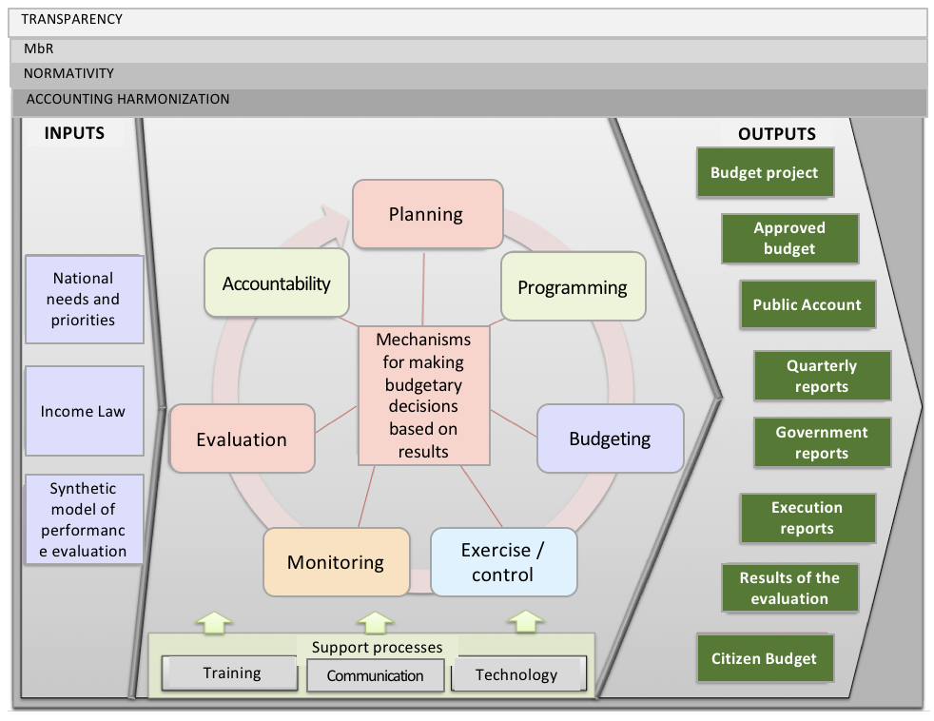
Ethical basis: Functions of fiscal policy
Pragmatic basis: Management by results
Provision
Provision public goods: security, order, justice.
Redistribution
It is based on the principle of social, regional, family, gender and personal equality.
Foment
It favors the generation of income and the creation of wealth of different groups of the population.
Stabilization
Contributes to the maintenance of macroeconomic equilibrium (employment, prices, interest rate, exchange rate) and economic growth.
,
Ideological basis: the role of the state
What do the Constitution say about the role of the state in the framework of human rights?
Except United States, all countries in the United Nations are adhered to CEDAW.
The Budget
Public spending is a fundamental tool when seeking to advance the equality of disadvantaged populations.
Governments allocate resources to priority issues, if resources are scarce, the issue is not a priority.
Does the government in your country use results-based management?

Slide 14
In the field of ideological basis we recognize pendulum movement in long cycles in economic history? More state or more market
More market
ECONOMIC LIBERALISM (eighteenth century to thirty years of the twentieth century)
NEOLIBERALISM Influence from the end of the seventies of the last century to the date
Protectionist state to strengthen the prince.
Stage of formation of the National States.
Welfare state: a strong State capable of regulating and achieving, through fiscal policy, the full employment of the economy.
Its adoption is generalized in the western world at the end of WW II - Marshall Plan
Adam Smith laissez-faire
The tasks of the government are to protect the life and property of the people.
Administrative government, which favors the development of an economic group.
Government that favors the development of an economic group.
Adopt structural adjustment policies.
MERCANTILISMO (XV century to XVIII century)
KEYNESIANISM (1930s to 1970s)
More state
Formation of the National States: The prince and his court
The representatives of industrial capital
The defenders of the Welfare Economy
The transnationals and the representatives of financial capital

Slide 15
The budget (income and public expenditure) is a very important issue to improve the quality of life of the population
The budget issue is ...
It is a powerful instrument of economic policy
Strategic
It is not just a technical issue.
It has to do with ideological issues related to the theory of the State.
Reports on the dominant ideology and long economic cycles
Reflects government priorities
It has implications for economic, political, social and cultural development.
Technical
Political
Influences people's quality of life

Slide 16
The principle of Equality
And human rights

Slide 17
How the Principle of equality is based Paraphrasing Alda Facio
Equality in another context
Equality as a right
Conclusion
As a noun it refers to the relationship between two such things, two automobiles. In mathematics an equality is an equivalence of two expressions or quantities.
As an adverb it can be used to say the same as in the phrase "it is also said of domestic animals that ...".
As an adjective it may be as a like, as in the phrase "two quantities equal to a third are equal to each other"; As indifferent, when someone says "everything gives me equal", or without variation as in the use of the expression "equal temperature."
In the field of the social, equality is a situation or context where people have the same rights and the same opportunities in a particular area or at a general level.
The great innovation introduced by the doctrine of human rights is to have made the principle of equality a legal norm.
This means that equality is not a fact but a value established precisely in the face of the recognition of human diversity.
The principle of equality, in almost all international human rights instruments, is not descriptive of reality, it is not presented in terms of being but of being a duty.
When speaking of the human right to equality, the right to equality between different women is also being discussed.
From the point of view of human rights, equality between the sexes does not mean that we are identical, nor that we are similar in ability and nature, but that we are equivalent.
This means that we are worth the same as human beings regardless of whether or not they have different abilities, abilities and natures.
If people were the same in the sense of being identical, that is, if we were similar in capacities, nature, skills, etc. - and specifically women and men - there would be no need for the human right to equality.

Slide 18
The CEDAW not only establishes the allocation of funds for the application of 'appropriate measures' but also requires the States Parties to allocate specific budgets for temporary special measures, aimed at accelerating equality between women and men.
CEDAW
CONVENTION ON THE ELIMINATION OF ALL FORMS OF DISCRIMINATION AGAINST WOMEN

Slide 19
Characteristics of Human Rights
Human rights are mainly "laws for States, made by States and on the obligations of States" OACNUDH
Universal
Of non-discrimination and equality
Of participation and inclusion
Indivisible, interdependent
Exigibles
Accountability and transparency
Integral and complementary
Progressive
The law Empire
Inalienable, indefinite and irrevocable
Irrevocable and non-transferable
Internationally protected
Source: Own elaborations based on information from the Office of the United Nations High Commissioner for Human Rights, OACNUDH (2011). 20 Keys to Understanding and Understanding Human Rights, Mexico. Available at http://www.coddehumgro.org.mx/sitio/archivos/cultura-paz/publicaciones/20claves%20ACDH.pdf. Pages 7, 8 and 11. Consulted on May 26, 2015.

Slide 20
The public budget is linked more to two principles of human rights
The universality
Applicable to all people without any distinction.
How many women and men are covered by investment and public spending?
The progressivity
Systematic progress of the exercise and enjoyment of human rights by the population
How fast is the coverage of public services, which women and men require?

Slide 21
Types of Human Rights
Civil and Political
Collectives: Right to the City
Economic, Social, Cultural, and Environmental DESCA
Specials: women, children
Groups on vulnerable groups: migrants, trafficking

Slide 22
Letter from Mexico City for the Right to the City
Democratic city
Right to self-determination
Right to freedom of opinion and expression.
Habitable city
Right to freedom of peaceful assembly and association.
Right to manifestation.
Right to freedom of choice and non-discrimination regarding education, culture, places of residence, among others.
Right of access to justice, relative to both individual and collective rights.
Right to participate in decision-making in public affairs, including populations in situations of discrimination.
Right to access, research and dissemination of public information.
Inclusive city
Right to life.
Right to equality before the law.
Right to non-discrimination.
Right to the difference.
Right to freedom of conscience.
Right to freely profess their religion.
Right to freedom of residence in the territory of the city.
Right to land and to a safe place to live.
Right to have basic public services (water, sanitation and energy).
Right to housing.
Right to freedom of movement.
Right to public transport and urban mobility.
Sustainable city
Right to live in a healthy environment.
Right to protection, preservation and improvement of the environment.
Right to access and use of urban and rural territory within sustainable environmental and economic conditions.
Productive city
Right to work in satisfactory and equitable conditions in social and gender terms.
Right to sufficient income that guarantees a dignified life.
Rights to organize (unions, cooperatives, among others).
The right to social security.
Right to participate in the production of the city.
Right to generate self-managed productive enterprises.
Educating city
Education rights.
Right to enjoy the benefits of scientific progress and its applications, including access to new information technologies and their periodic updating.
Right to conservation, development and dissemination of science and culture.
Right to freedom for scientific research and creative activity.
City safe from disasters and accidents.
Right to personal security and physical integrity in the face of risks and disasters.
Right to a safe place to live.
Right to safe spaces where to develop individual and collective activities.
Safe city free of violence
Right to personal security and integrity (physical, sexual, psychological, and moral, among others).
Right to a life free of violence, both in the public and in the private sphere.
Right to privacy and privacy: to private and family life in its various forms and to protection against intrafamily violence.
Right to peaceful, solidary and multicultural coexistence.
Right to protection against forced evictions.
Healthy city
Right to a healthy environment.
Right to the highest possible level of physical and mental health.
Right to adequate food.
Right to sufficient and quality water.
Right to sanitation services and garbage management.
Sexual and reproductive rights.
Coexisting and culturally diverse city
Right to participate in cultural life.
Right to cultural, linguistic and religious freedom.
The right of people to have free time and accessible public spaces for coexistence and encounter.
Right to have public spaces suitable for the free expression of their cultural manifestations.
Right to have quality recreational and sports spaces.
Right to community coexistence.
Right to manifestation and debate in public spaces.
Notes:
United States Agency for International Development (USAID)
La teoría de la elección u opción pública (Public choice theory), trata de utilizar la economía para estudiar problemas típicos de ciencias políticas…. la teoría de la elección pública modela a los gobierno como un conjunto de funcionarios que, además de buscar el interés público, puede que actúen en beneficio propio, por ejemplo, en el modelo de maximización de presupuesto de la burocracia, posiblemente sacrificando eficiencia económica en el proceso.2 5La teoría de la elección pública moderna nació del trabajo del Duncan Black, a veces llamado el "padre de la teoría de la elección pública".6 En una serie de publicaciones de 1948, que culminaron en la "Teoría de los Comités y las Elecciones" (1948)…W
Coste de transacción
En economía y disciplinas relacionadas, un coste de transacción es un coste incurrido para realizar un intercambio económico, más precisamente una transacción en el mercado. El coste no existe en el marco de una competencia perfecta.
La idea de un coste del sistema de precios fue evocada por primera vez por el economista Ronald Coase en su artículo The Nature of the Firm (1937). Coase explica que "cuando se desea operar una transacción en un mercado, es necesario investigar a los contratistas, proporcionarles ciertas informaciones necesarias y establecer las condiciones del contrato, llevar a cabo las negociaciones que instauren un verdadero mercado, establecer una estructura de control de las respectivas prestaciones de obligaciones de las partes, etc."¹
Este concepto permite explicar, según Coase, por qué todas las transacciones no son transacciones de mercado y, por lo mismo, la existencia de empresas o firmas que pueden limitar eficazmente sus costos al imponer la cooperación entre sus empleados; sin embargo, es a John Kenneth Arrow² a quien se debe la expresión "costo de transacción". Y fue Oliver Williamson quien va a desarrollar y formalizar la aproximación de las organizaciones económicas por su sesgo al interno de lo que denomina justamente la teoría de los costos de transacción…. Por ejemplo, la mayor parte de las personas debe pagar una comisión a su broker cuando compran o venden una acción; esta comisión es un coste de transacción de realizar un negocio con acciones. Ahora bien para comprar un producto, los costos no solo se limitarán al precio del producto en sí, sino también a la energía y esfuerzo que requiere averiguar cuál de los variados productos se prefiere, dónde se consiguen y a qué precio, el costo de viajar hacia el punto de compra, el tiempo de espera para comprarlo; todos estos costos son los costos de transacción. Por eso, cuando se evalúa racionalmente una transacción potencial, es importante considerar los costes de transacción que podrían resultar significativos. W
Taylorismo
El taylorismo, en organización del trabajo, hace referencia a la división de las distintas tareas del proceso de producción. Fue un método de organización industrial, cuyo fin era aumentar la productividad y evitar el control que el obrero podía tener en los tiempos de producción. Está relacionado con la producción en cadena. W
Post Taylorismo
post... algo. ¿Postaylorismo, postfordismo, post-Estado social o del bienestar? http://revistas.ucm.es/index.php/CRLA/article/viewFile/CRLA0303220067A/32380
Teoría de la agencia
La teoría de la agencia es una técnica empresarial por la cual una persona o empresa (el principal) solicita a otra persona (el agente) realizar un determinado trabajo en su nombre. Para que exista una relación de agencia, el agente debe ser autorizado por el principal a suscribir, modificar o cancelar contratos con terceros en nombre del principal.
En cierto modo, se trata de una medida de representación empresarial con validez perfectamente legal por la cual se hace compatible actuar separando en múltiples ocasiones la propiedad de la empresa y su control o gestión, gracias a que el acuerdo, a pesar de realizarse por el agente, tendrá validez legal y real como si lo hubiera realizado el principal en primera persona.
Es por este motivo por el que la teoría de la agencia es un concepto muy presente en el ámbito de la empresa, especialmente en la dirección, gestión y administración. El hecho de que plantee las bases en relaciones de separación entre propiedad y dirección da lugar a diferentes situaciones de representación profesional o subcontratación.
A través de la teoría de la agencia se desarrolla un sistema que acoge diferentes posibilidades dentro de la rama organizativa empresarial, de cara a la consecución de objetivos de las sociedades de manera más eficiente.
El mecanismo básico que plantea esta teoría es que el fin empresarial o laboral acordado entre principal y agente se acuerda bajo unas condiciones económicas o contractuales como compensación a su realización. Dentro de las relaciones que caben en la teoría de la agencia un dato a tener en cuenta es que cada parte busca su propio interés o la maximización de su utilidad al entrar en uno de estos acuerdos mercantiles.
Dentro de estas posibilidades está la contratación de administradores o gestores que no poseen parte de la propiedad de la empresa o la ya citada subcontratación de servicios. En ocasiones la subcontratación ayuda a las sociedades a conseguir mejores resultados que realizando directamente determinada actividad productiva, o al menos alguna de sus fases. Por ejemplo, hay empresas a las que por diferentes motivos les beneficia más contar con una empresa externa para el transporte de sus bienes en lugar de hacer dicha tarea por sí mismas.
Otro ejemplo común de este tipo de relación de agencia es la que mantienen los accionistas de una empresa y los directivos de la misma.
Desventajas planteadas por la teoría de la agencia
Conlleva costes productivos, derivados del propio acuerdo alcanzado y su regularización, así como la compensación a la persona o empresa contratada.
El poder de decisión cambia de mano y esto puede dar lugar a importantes diferencias de criterio empresarial y la aparición de intereses no comunes. El caso más acentuado de este tipo de situaciones se denomina “problema de agencia” y es un problema de riesgo moral.
El incumplimiento de los objetivos en que se centra el acuerdo pueden suponer multas, sanciones y otros muchos costes relacionados.

Slide 23
Basic concepts
Of gender

Slide 24
Basic concepts to introduce us to the issue of equality between women and men
Sex
The differences and biological, anatomical and physiological characteristics that define women and men.
Gender (not equivalent to women)
Social construction of sexual differences in a historical moment and place, learned from socialization. It is expressed in a set of specific cultural characteristics that identify the differentiated social behavior of women and men and the relationships that are established between them.
Gender gap
Differentials in access, participation and control of men and women over resources, services, opportunities and benefits of development.
Affirmative actions
Specific temporary measures that are put in place to provide specific benefits to disadvantaged and less representative populations, in this case women.
Transversality
Instrumental strategy for gender equality that calls for the systematic incorporation of the theme of equality between women and men in all the components of a structure, economic, social, cultural and environmental policy.

Slide 25
Gender Sensitive Budgets
Its essence

Slide 26
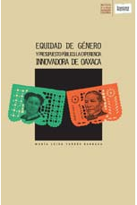
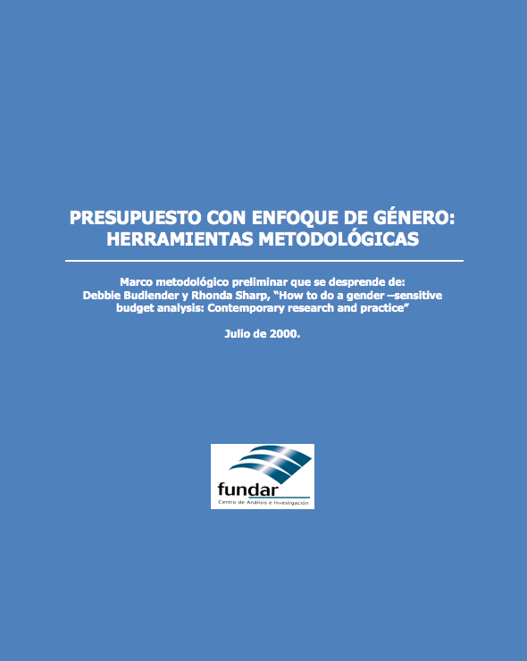
What are gender sensitive budgets?
A budgetary design of comprehensive public income and expenditure that considers the needs and interests differentiated between women and men in all areas of government work, which seeks to eradicate the inequality gaps, to access substantive equality between them, based on rights humans with a gender perspective.
It deals with the visibility of inequality in the sexual distribution of work in society and considers and incorporates the contribution of unpaid work, basically of women, to the national wealth and the quality of life of all the inhabitants of the country.
Notes:
Los presupuestos públicos con perspectiva de género son una herramienta específica dirigida a reconocer las desigualdades y remediarlas a través de la asignación de recursos públicos.
Las condiciones específicas de las mujeres y los hombres, y las diferencias entre ambos, no son reconocidas bajo el supuesto de que los objetivos e instrumentos políticos son ampliamente aplicables, de ahí que sean vistos como neutrales al género, aún cuando los impactos de las políticas económicas y sociales no lo son.
La ceguera de género es la desconsideración de la macroeconomía hacia el trabajo no remunerado, realizado predominantemente por mujeres y sin el que no funcionarían la economía ni los hogares. Los compromisos como gobierno hacia la eliminación de las desigualdades existentes debe incluir el reconocimiento de la contribución de las mujeres a la economía.
El presupuesto es un instrumento técnico por medio del cual un gobierno refleja sus prioridades políticas, traduciendo estos compromisos en términos monetarios, una declaración gubernamental de principios y valores, ya sea de manera explícita o implícita. Aquellos asuntos que son una prioridad en la agenda política implican una adecuada asignación de recursos. Se tiende a asumir que todas las personas son iguales, no se reconocen las distinciones más evidentes que se derivan de la clase, el sexo, la edad, la raza, la etnicidad, la sexualidad y la ubicación geográfica.
Así como los presupuestos han sido instrumentos para transmitir y reproducir sesgos de género, también ofrecen una posibilidad para transformar y remediar las desigualdades de género existentes. Los presupuestos ofrecen una base para traducir en acciones concretas los compromisos hechos para la igualdad de género. Además son una herramienta para enriquecer la rendición de cuentas.
http://www.inmujer.df.gob.mx/wb/inmujeres/que_son_los_presupuestos_publicos_con_perspectiva_

Slide 27
The stages, mechanism and instruments
The public policy process

Slide 28
Methodology based on management by results, harmonized to the Right to the City The whole process, or selection of the follow-up an specific theme of the New Urban Agenda
Cross cutting of the gender perspective (women and men), age, and explicit inclusion of diverse women, throughout the process.
Participatory Process
What does national and local legislation say about it?
What of the Cedaw, Belem do Para, CESCR, CCPR conventions are included in national and local legislation?
LEGISLATION
Harmonization
What does the country's Development Plan say on the subject?
How do you incorporate the guidelines of international frameworks and action plans? ODS, NAU, Sendai, Addis Ababa, Refugees and Migration, Beijing, Cairo, etc.
PLANNING
PROGRAMMING
Ehat do the programs, national, subnational and local say?
What does your logical frame exercise say? Your Indicator Matrices (MML) do they have an Indicator Evaluation Systems (IES)? Are the indicators of the SDGs used?
Alignment
BUDGET
Does the budget design use the results-based budgeting method?
How much per capita budget does the government allocate to the issue?
Does the local government make a participatory budget?
Sufficiency
EXERCISE AND CONTROL
Are there internal systems for controlling public expenditure in public agencies?
Are there open government practices?
Are there periodic progress reports to Congress or to society?
Are there monitoring activities?
MONITORING
Efficiency
In the Systems Performance Evaluation
Are the Progress Indicators used?
Is the SDG indicator system being incorporated?
Are there external evaluations of the results of government programs?
Citizens Observatories like
Systemic intervention
EVALUATION
Effectiveness
Are there Citizen Observatories?
ACOUNTABILITY
Open government is present?
Are there public accountability mechanisms?
Complementary work to existing government Audits

Slide 29
The stages of the public policy process
M&E
Citizen observatories for the follow-up of the NAU (Sendai Framework, Paris Agreement, Addis Ababa Agenda, SDG, etc.) with a gender perspective
Results-based Budgeting
Execution
Monitory
Evaluation
Transparency and accountability
Legislation
Plans and programs
Harmonization with human rights conventions
Alignment with Action Platforms (NUA, Sendai, Addis Abeba, etc.)
Performance Evaluation System
Access to information
Participatory Budgets
Gender sensitive budgets
Adoption of indicators
Consideration of indicators
Registration and monitoring of progress indicators
System of SDG Indicators
Urban Prosperity Index

Slide 30
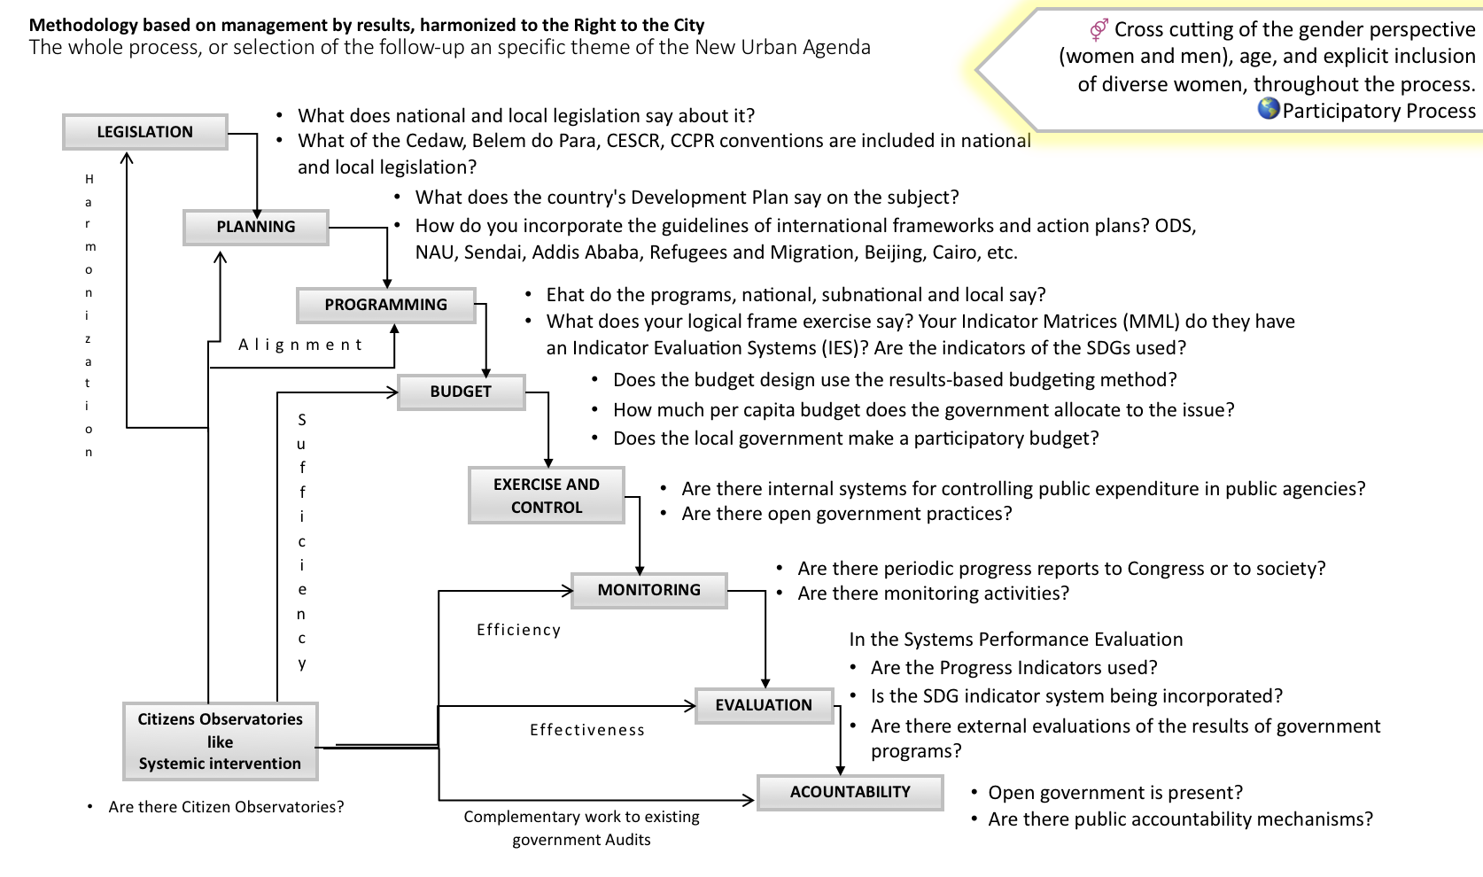
Management by Results Instruments and mechanisms to associate
Traditional budgets measure the resources consumed
SDG Indicators All Emphasis on objectives 5 and 11
Result-Based Budget measures the production of public goods and services, and the impact they generate in society, taking into account objectives and targets
Indicators of Progress (Comity Belem Do Para)
Result-Based Budget
Structural: reception of rights
They examine whether the regulatory framework and the strategies that the government implements are adequate and effective to guarantee each right.
What is a Result-Based Budget? A methodological tool and organizational culture model
Objective
That the public resources be assigned as a priority to the programs that generate the greatest benefits to the population
and
That the design of those that are not working correctly be corrected
Process: institutional context, financial and budgetary commitment
They measure the quality and magnitude of the government's institutional, financial and budgetary efforts to implement the protected rights.
From results: institutional or governmental capacities What is achieved?
They measure the real impact of strategies, programs, and government interventions in the area of equal rights guarantees.
Gender Responsive Budgets
1. Productivity.
The one that in its design considers the interests and the differentiated needs of women and men and seeks to close the gaps of inequality
6. Governance and urban law.
Citizen Observatories
2. Development infrastructure.
Instrument of measurement, of impulse of public politics and of systematic evaluation of the conditions of prosperity of the cities. It needs to incorporate indicators disaggregated by sex.
Urban Prosperity Index
Participatory budget
5. Environmental sustainability.
3. Quality of life.
It is a process of direct, voluntary and universal democracy, where the population can discuss and decide on the budget and public policies of a territory.
4. Equity and social inclusion.

Slide 31
Countries and regions that apply the Management for Results in the design in governmental programmatic-budgetary
Latin America and the Caribbean |  |  |  | Europe | North America | Africa
North America | Central America | South America | Caribbean
México | Belize | Argentina | Bahamas | Germany | United States | Burkina Faso
 | Costa Rica | Brazil | Barbados | Austria | Canada | Cabo Verde
 | Guatemala | Chile | Guyana | Denmark |  | Comoros
 | Honduras | Colombia | Haiti | Finland | Asia | Cote d'Ivoire
 | Nicaragua | Ecuador | Jamaica | Francie | Korea | Gambia
 | Panamá | Paraguay | Republic Dominican | Netherlands | Turkey | Kenia
 | El Salvador | Peru | Surinam | United Kingdom |  | Mali
 |  | Uruguay | Trinidad y Tobago | Sweden |  | Morocco
 |  |  |  | Switzerland |  | Namibia
 |  |  |  |  |  | Senegal
 |  |  |  | European Union |  | Tanzania
Fuentes: Kaufmann, 2015. Escudero 2007. http://idea-international.org/es/logros/index.html |  |  |  |  |  | Uganda
 |  |  |  |  |  | Zambia

Slide 32
Approaches to the inclusion of women in development, their evolution over time and their present coexistence
Policies Neutral to Gender.- Actions that reproduce gender roles, favor those who control resources.
Policies for Women.- They do not favor transformation and can leave intact the existing distribution of resources and responsibilities.
Transformative or gender redistributive policies.- They seek to transform power relations. Promote redistribution with criteria of equality in access and control of resources, responsibilities and power
Politics | Women in Development MED – Approaches |  |  |  | Gender in Development GED
 | Wellness | Anti-Poverty | Efficiency | Equity | Empowerment
 | 1950-70 | 1970´s | 1980´s | 1985 | Start I 1990
Diagnosis | Motherhood is the most important role of women in society | Economic inequality between men and women is not linked to subordination but to poverty | Women as an "underutilized resource" for the achievement of economic goals. | Recognizes women as productive agents, but assumes that market and income eliminate unequal power relations between women and men. | The unequal power relations (of class and gender) that do not allow an equitable development and the full participation of women in the fruits of development.
Objetivo | Place the mother-child elations as the unit of attention. | Help poor women to increase their productivity. | Increase women's productivity to ensure that development is more efficient and effective | Address education and employment as basic conditions to increase women's productivity. | Build new economic, political and social structures that eradicate the structures of exploitation and discrimination. It questions discrimination and patriarchal power in the various spheres of private and public life.
Programs and services. | Food aid, family planning and nutrition. | Training for women in technical skills. | Training for women in technical skills. | Formation for women. | Economic autonomy: capacity to generate own revenues and control assets and resources. Political autonomy: access to decision-making positions under conditions of equality: parity. Physical autonomy: the right of women to live a life free of violence.

Slide 33
Practical needs and strategic interests
Solution Attention to practical needs
Solution Attention to strategic interests
Result Improvement of quality of life Lighten your gender role
Result Empowerment Transform your gender role
Ejemplos
Practical needs
Strategic interests
Conditions of survival: lack of employment, insufficient income, access to education, health, drinking water, housing, etc. Unequal responsibilities in domestic work and care.
Salaries equal to men for work of equal value, Right to land ownership, Eradication of sexual harassment, Freedom of choice about motherhood, Participation in the design of plans and programs, Access to decision-making positions, etc.

Slide 34
Fundamental recommendation
The general recommendation that should permeate the budget management of the government is that the entire public budget should be made with a gender perspective, because all public action is to meet the diverse and differentiated needs and interests of the population composed of men and women.
Women are not a subgroup like others classified as vulnerable groups - disability, elderly, poor, etc. - we are part of all social subgroups and we are more than half of the population in most countries.
This approach is the one that should prevail, which will make visible the equal distribution of public resources associated with indicators that allow measuring the closing of inequality gaps between women and men, which in some cases will benefit men, if it is they who are disadvantaged, as in some countries in school achievement, for example. That is what the incorporation of the gender perspective in all government programs, in all the institutional work.
The question that should be asked each server and public servant is always in what form the programs, projects and actions developed by the public body in which I work, contributes to the population of women and men of all ages to access and enjoy their rights humans in an equal status? To do this, they must understand equality as a principle of human rights and not as a similarity.
The international instruments available in the form of conventions and the United Nations Global Agenda, and the institutional architecture for government management that is used in many countries of the world favor the possibility of accelerated progress of public policies with a gender perspective, part the solution is to understand how to do it.

Slide 35
ANNEXED Inequality gaps
Between men and women
Some examples

Slide 36
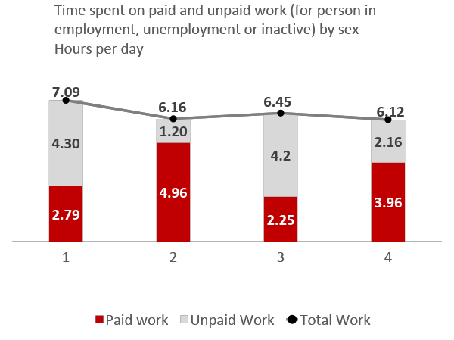
Gaps in inequality between women and men
Use of time
Wage gap in the European Union and the Eurozone in 2015 WEF
Percentage that the average gross hourly wage of women is lower than that of men
Note: developed countries were 37 from which the information was collected, and 27 from the developing countries.
Source: United Nations, 2015, The World's Women 2015: Trends and statistics (New York, United Nations, Department of Economics and Social Affairs, Statistics Division). Figure 4.24 of Chapter 4. Taken from ILO 2016, Women at Work: Trends 2016, International Labor Office "
The smallest wage gaps in this graph are 5.5% in Italy and Luxembourg, and the highest in Estonia of 26.9%.
More women than men opt for parental leave and only 65.8% of women with small children across the EU work, compared to 89.1% of men. Across Europe, about 32% of women work part-time, compared to only 8% of men.
Source: https://www.weforum.org/en/agenda/2018/02/estos-son-los-los-los-motivos-de-la-brecha-salarial-de-genero
Notes:
Las cifras del Eurostat sobre la brecha salarial
https://www.weforum.org/es/agenda/2018/02/estos-son-los-motivos-de-la-brecha-salarial-de-genero
Para empezar hay que tener los datos claros. Para ello, utilizaremos la diferencia de retribución salarial no ajustada entre hombres y mujeres que es el indicador utilizado para analizar los desequilibrios salariales entre hombres y mujeres. El Eurostat lo define en su cálculo como la diferencia entre el salario medio bruto por hora de los hombres y el de las mujeres expresado como porcentaje del salario medio bruto por hora de los hombres.
Para el conjunto de la economía, en 2015, los ingresos brutos por hora de las mujeres eran, en término medio, un 16,3 % inferiores a los de los hombres en la Unión Europea y un 16,8 % en la Eurozona. En los diferentes Estados miembros del bloque económico, la diferencia salarial entre hombres y mujeres tiene una amplitud de 21 puntos porcentuales, oscilando entre el 5,5 % en Italia y Luxemburgo y el 26,9 % en Estonia.
En el caso de España, los ingresos brutos por hora de las mujeres son 14,9% inferiores al de los hombres -la misma brecha que en Noruega., un dato ligeramente inferior a las brechas salariales por género tanto de la Unión Europea como de la Eurozona.
Como dato adicional, muchos de los países posicionados con los mayores niveles de renta en Europa, son también los que presentan mayores diferencias salariales por hora entre hombres y mujeres: Alemania (22%), Austria (21,7%), Reino Unido (20,8%), Suiza (17,7%) y Finlandia (17,3%).

Slide 37
The wage gap between women and men widens
Salaries
Global average annual revenue in 2017, WEF
The global income index between women and men is expanding
Average salary for men
Average salary for women
Thousands of dollars
Source: Global Report on the Gender Gap 2017 of the World Economic Forum, 144 countries, https: //www.weforum.org/agenda/2017/11/pay-equality-men-women-gender-gap-report-2017

Slide 38
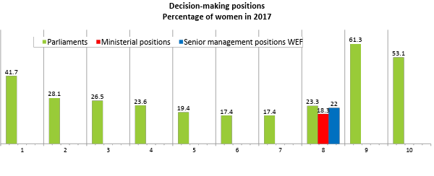
Inequality gaps in decision-making positions
Note: In June 2017, only 23.3% of national parliamentarians were women, which means that the proportion of women parliamentarians has increased very slowly since 1995, when it was 11.3%
* / Including the Nordic countries
Source: http://www.unwomen.org/en/what-we-do/leadership-and-political-participation/facts-and-figures
Global Report on the Gender Gap 2017 of the World Economic Forum, 144 countries, https: //www.weforum.org/agenda/2017/11/pay-equality-men-women-gender-gap-report-2017

Slide 39
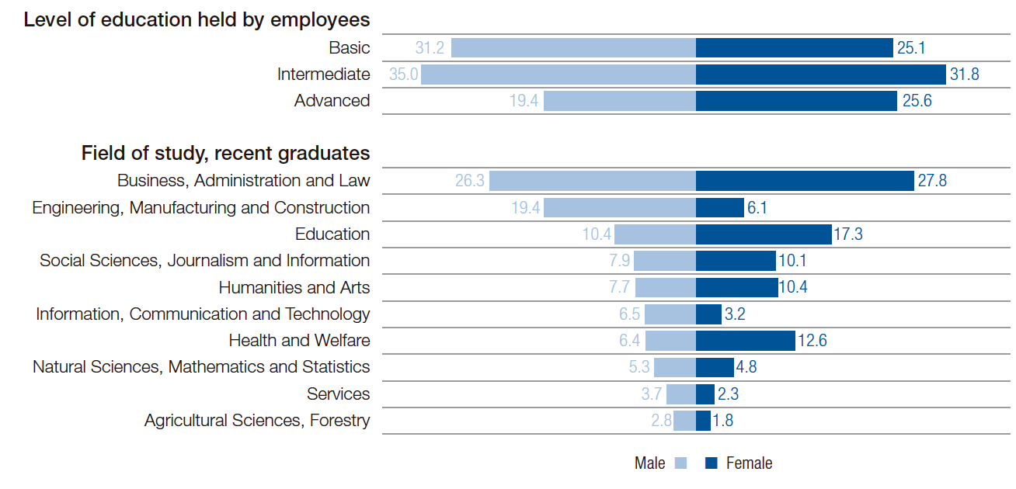
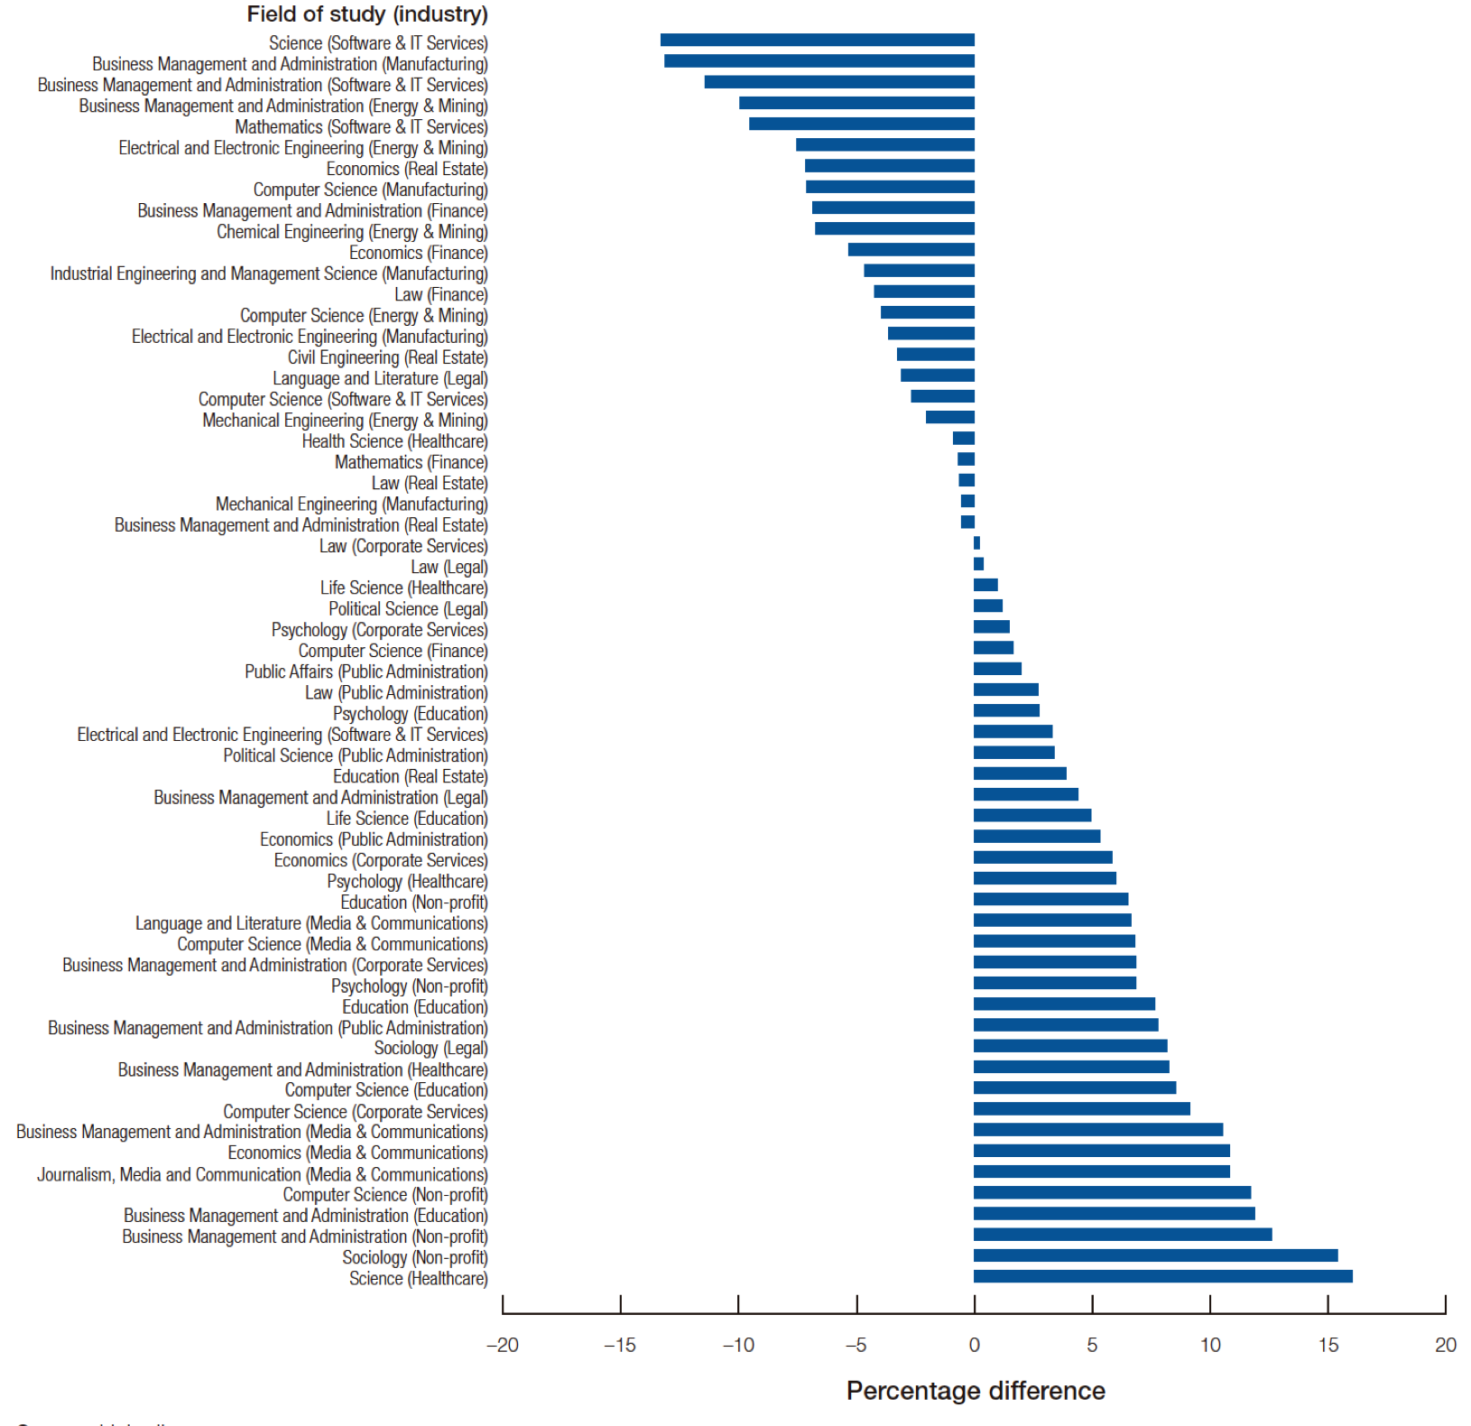
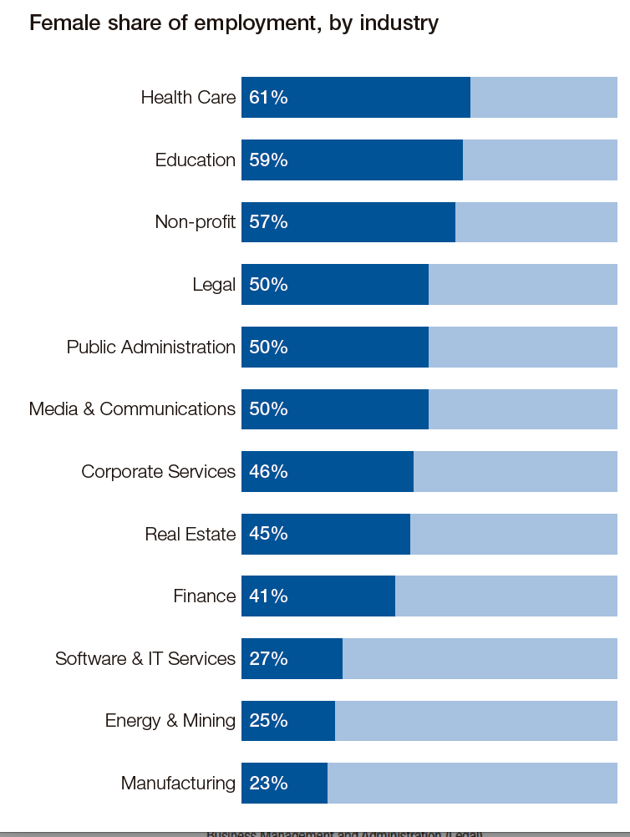
Industry under-representation of women relative to overall talent pool, by field of study
Employee educational attainment by level, field of study and gender (%)
Source: World Economic Forum calculation; data from ILOSTAT, UNESCO Institute for Statistics. Global Report on the Gender Gap 2017 of the World Economic Forum
Note: Global average, unweighted by population.
Share and evolution of female hires, various industries/ Participación y evolución de mujeres contratadas, diversas industrias
Source: LinkedIn. Global Report on the Gender Gap 2017 of the World Economic Forum.
Note: Percentage point difference between share of all female LinkedIn members holding degrees in each field of study and those employed in stated industry. Top 5 degrees for each industry.
Source: Global Report on the Gender Gap 2017 of the World Economic Forum.

Slide 40
Magdalena García Hernández garciamagdalenah@gmail.com
FOR YOUR ATTENTION, THANK YOU VERY MUCH

